Slide 1
Introduction to Artificial Intelligence
Introduction to Artificial Intelligence
CHAPTER TWO
INTELLIGENT AGENTS Artificial Intelligence
Notes:
1

Slide 2
Introduction to Artificial Intelligence
Intelligent Agents
Agents and Environments
Acting of Intelligent Agents (Rationality)
Structure of Intelligent Agents
Agent Types
Notes:
2

Slide 3
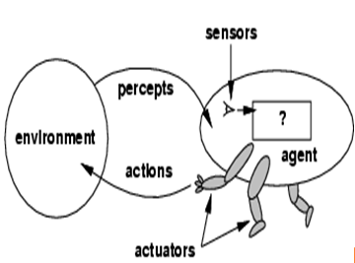
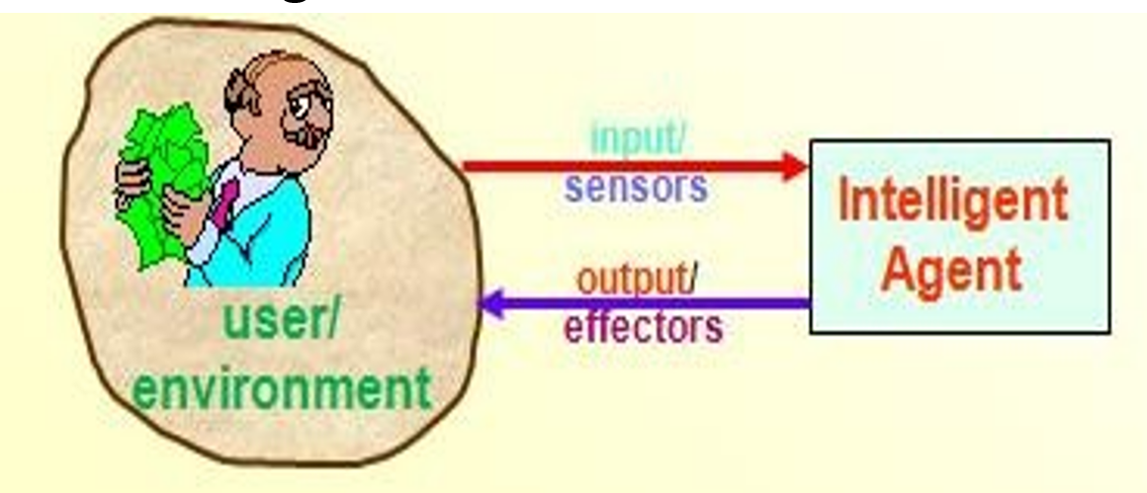
Introduction to Artificial Intelligence
Agents and Environments
Agent: is anything that can be viewed as perceiving its environment through sensors and acting upon that environment through effectors/actuators to maximize progress towards its goals.
Notes:
3

Slide 4
Introduction to Artificial Intelligence
Cont...
An intelligent agent is a system that:
perceives its environment (which may be the physical world, a user via a GUI, a collection of other agents on the the Internet, or other complex environment);
reasons to interpret perceptions, draw inferences, solve problems, and determine actions; and
acts upon that environment to realize a set of goals or tasks for which it was designed.
Notes:
4

Slide 5

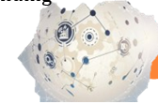
Introduction to Artificial Intelligence
Cont..
There are a number of agents such as:
Human agent: - A human agent has eyes, ears, and other organs for sensors, and hands, legs, mouth, and other body parts for effectors/ actuators.
Robotic agent: - A robotic agent substitutes cameras and
infrared range finders for the sensors and various motors for the effectors/actuators.
A software agent has encoded bit strings as its percepts and actions.
- receives Keystrokes, file contents, network packages as sensors/ sensory inputs and acts on the environment by displaying on the screen, writing files, and sending network packets as actuators.
Eg. A thermostat detecting room temperature
Actuator something that allow agent to take an action.
Notes:
5

Slide 6

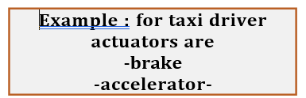
Introduction to Artificial Intelligence
Cont..
A sensor is a device that detects and responds to some type of input from the physical environment.
It allow agent to perceive it’s environment
Actuator something that allow agent to take an action.
Example : for taxi driver sensors are
-cameras
-GPS
-speedometer etc..
Notes:
6

Slide 7
Introduction to Artificial Intelligence
Rational Agent
An ideal rational agent is the one, which is capable of doing expected actions to maximize its
performance measure, on the basis of :
Its percept sequence
Its built-in knowledge base
What is performance measure?
how—the criteria that determine how an agent are successful.
E.g: performance measures for taxi driver are:
-fast
-Safe
-Legal…
Notes:
7

Slide 8
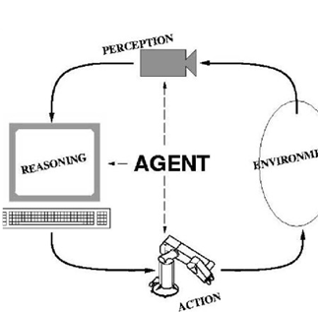
Introduction to Artificial Intelligence
Cont...
A rational agent is one that does the right thing.
o Right action is the one that will cause the agent to be most successful
A performance measure embodies the criterion for success of an agent's behavior.
Notes:
8

Slide 9
Introduction to Artificial Intelligence
ACTING OF INTELLIGENT AGENTS (RATIONALITY)
An agent should strive to "do the right thing"; based on what it can perceive and the actions it can perform
What is rational at any given time depends on four things:
The performance measure that defines the criterion of success.
The agent's prior knowledge of the environment./ environment
The actions that the agent can perform./actuator PEAS
The agent's percept sequence /sensor
the performance measure as an objective criterion used to for success of an agent’s behavior.
E.g. performance measure of a vacuum-cleaner agent could be amount of dirt cleaned up, amount of time taken, amount of electricity consumed, amount of noise generated, etc.
Notes:
9

Slide 10
Introduction to Artificial Intelligence
Cont..
Activity 1:
Discuses what are the PEAS features of the following agent types.
Medical Diagnosis system
Satellite image analysis
Part-picking-robot
Taxi driving
Instructive English Tutor
Refinery controller
Notes:
10

Slide 11
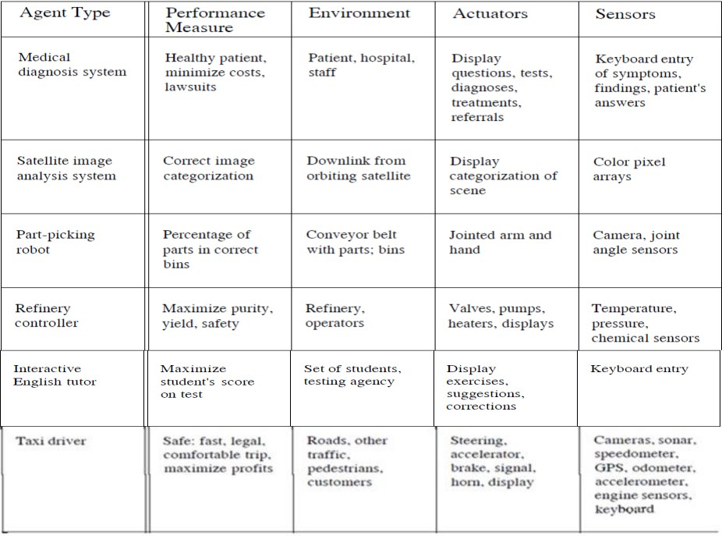
Introduction to Artificial Intelligence
Cont...
Notes:
11

Slide 12
Introduction to Artificial Intelligence
Cont...
Types of Environment:
Fully observable/ partially Observable
Deterministic/ Stochastic
Episodic/Sequential
Single-agent/Multi-agent
Static/Dynamic
Discrete/ Continuous
Notes:
12

Slide 13
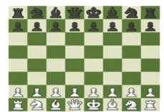

Introduction to Artificial Intelligence
Fully observable/ partially Observable
Fully observable :an agent can always see the entire state of the environment.
Example: chess
Partially observable :an agent can never see the entire state of the environment.
Example: Card game
Notes:
13

Slide 14
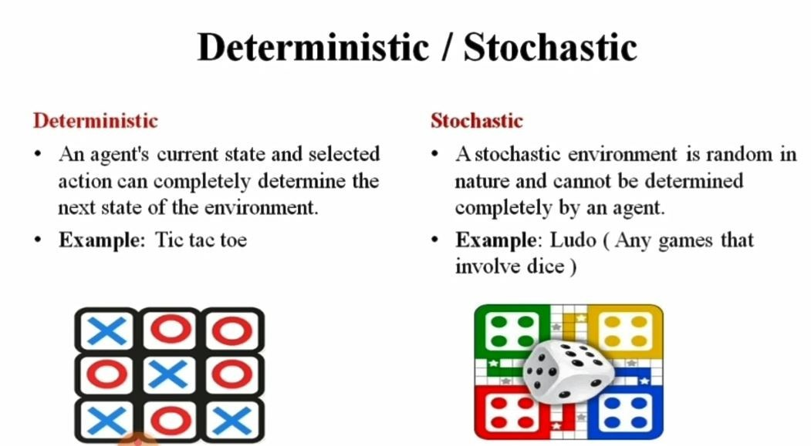
Introduction to Artificial Intelligence
Con’t…
Notes:
14

Slide 15
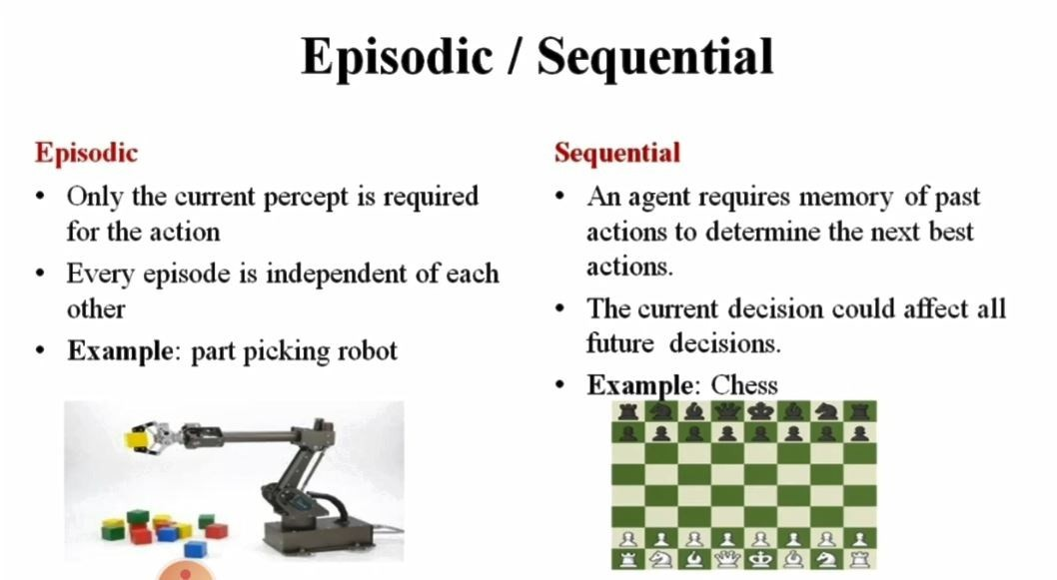
Introduction to Artificial Intelligence
Con’t..
Notes:
15

Slide 16
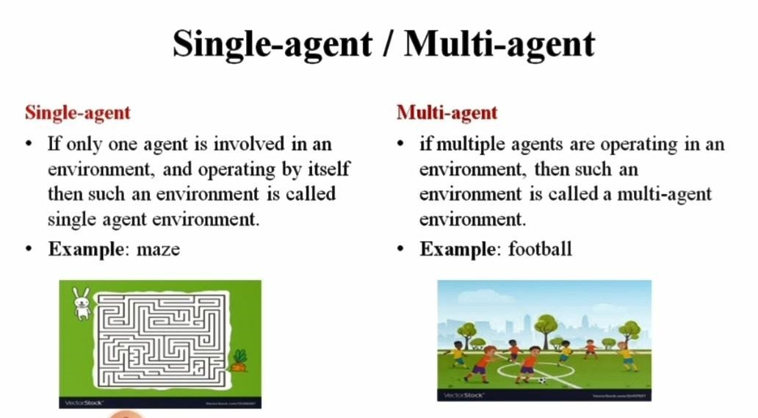
Introduction to Artificial Intelligence
Cont..
Notes:
16

Slide 17
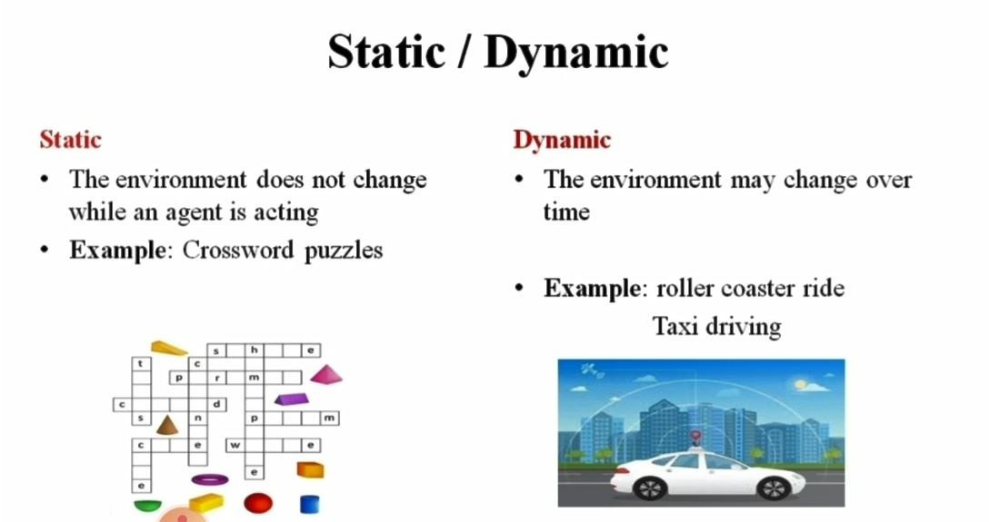
Introduction to Artificial Intelligence
Cont..
Notes:
17

Slide 18
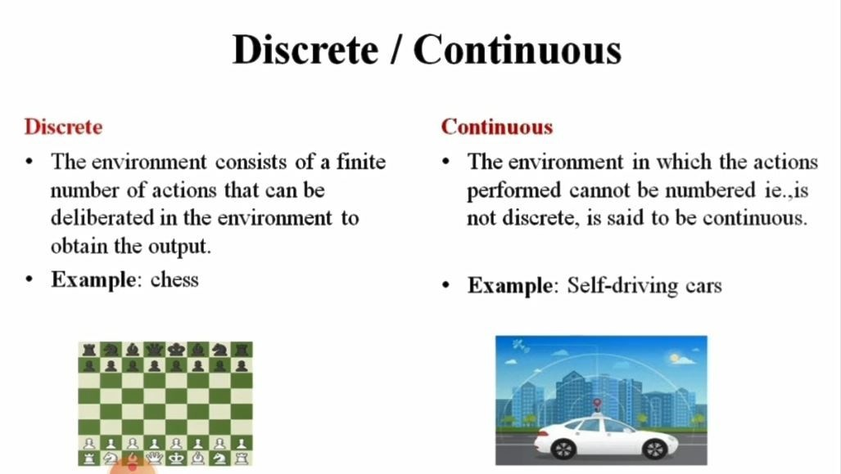
Introduction to Artificial Intelligence
Cont..
Notes:
18

Slide 19
Introduction to Artificial Intelligence
Cont..
Activity 2:
Group the following Task agents with the corresponding Environments
Crossword puzzle
Chess with a clock
Poker
Part-picking-robot
Taxi driving
Image analysis
Instructive English Tutor
Notes:
19

Slide 20
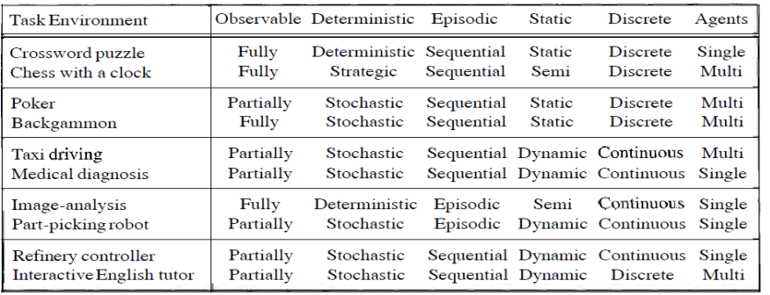
Introduction to Artificial Intelligence
Cont..
Examples of task environments and their characteristics
Notes:
20

Slide 21
Introduction to Artificial Intelligence
STRUCTURE OF INTELLIGENT AGENTS
A rational agent is one that does the right thing.
The job of AI is to design the agent program: a function that implements the agent mapping from percepts to actions
This program will run on some sort of computing device, which we will call the architecture.
The architecture might be a plain computer, or it might include special-purpose hardware for certain tasks, such as processing camera images or filtering audio input
It might also include software that provides a degree of insulation between the raw computer and the agent program,
In general, the architecture makes the percepts from the sensors available to the program, runs the program, and feeds the program's action choices to the effectors as they are generated. The relationship among agents.
Agent = architecture + program
Notes:
21

Slide 22
Introduction to Artificial Intelligence
Types of agent
There are around 5 types of agent:
Simple reflex agents
Model-based reflex agents
Goal-based agents
Utility-based agents
Learning agents
Notes:
22

Slide 23
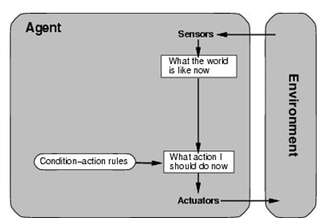
Introduction to Artificial Intelligence
Simple reflex agents
Simple reflex agents act only on the basis of the current percept, ignoring the rest of the percept history.
The agent function is based on the condition-action rule: if condition then action.
Work on environment is fully observable.
They choose actions only based on the current percept.
Agent Their environment is completely observable
Notes:
23

Slide 24
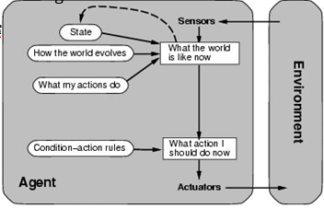
Introduction to Artificial Intelligence
MODEL-BASED REFLEX AGENT
Something that do not know about the whole world has knowledge partial world
A model-based agent can handle a partially observable environment.
Its current state is stored inside the agent maintaining some kind of structure which describes the part of the world which condition is performed
Notes:
24

Slide 25
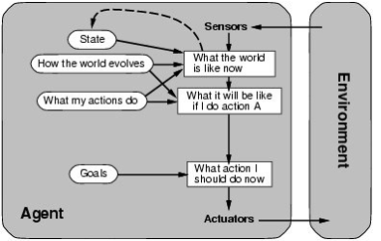
Introduction to Artificial Intelligence
GOAL-BASED AGENT
Goal-based agents further expand on the capabilities of the model-based agents, by using "goal" information.
Goal information describes situations that are desirable.
This allows the agent a way to choose actions
Knowing something about current state of environment is not always enough to decide what to do.
Agent also needs some sort of goal information
Notes:
25

Slide 26
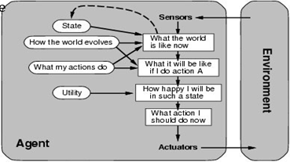
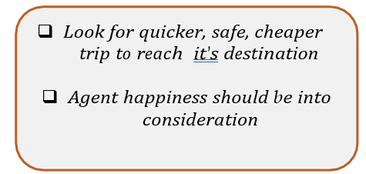
Introduction to Artificial Intelligence
UTILITY-BASED AGENT
Goal-based agents only distinguish between goal states and non-goal states
They choose actions based on a preference (utility) for each state.
Goals are inadequate when :
There are conflicting goals, out of which only few can be achieved.
Goals have some uncertainty of being achieved and you need to weigh likelihood of success against the importance
Notes:
26

Slide 27
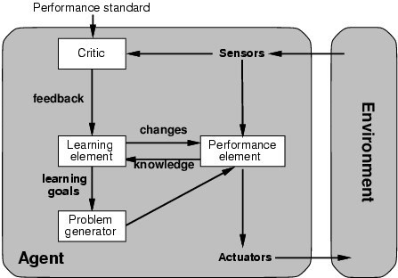
Introduction to Artificial Intelligence
LEARNING AGENT
Learning has an advantage that it allows the agents to initially operate in unknown environments and to become more competent than its initial knowledge alone might allow.
Learning element – responsible for making improvements
Performance element – responsible for selecting external actions (it is what we had defined as the entire agent before)
Problem generator is responsible for suggesting actions that will lead to a new and informative experiences
Notes:
27

Slide 28
Introduction to Artificial Intelligence
Cont…
THE END OF CHAPTER TWO
Notes:
28

